Slide 1
Oxford Reunion October 2024 Sixties Quiz
Last updated 6 October 2024 FINAL

Slide 2
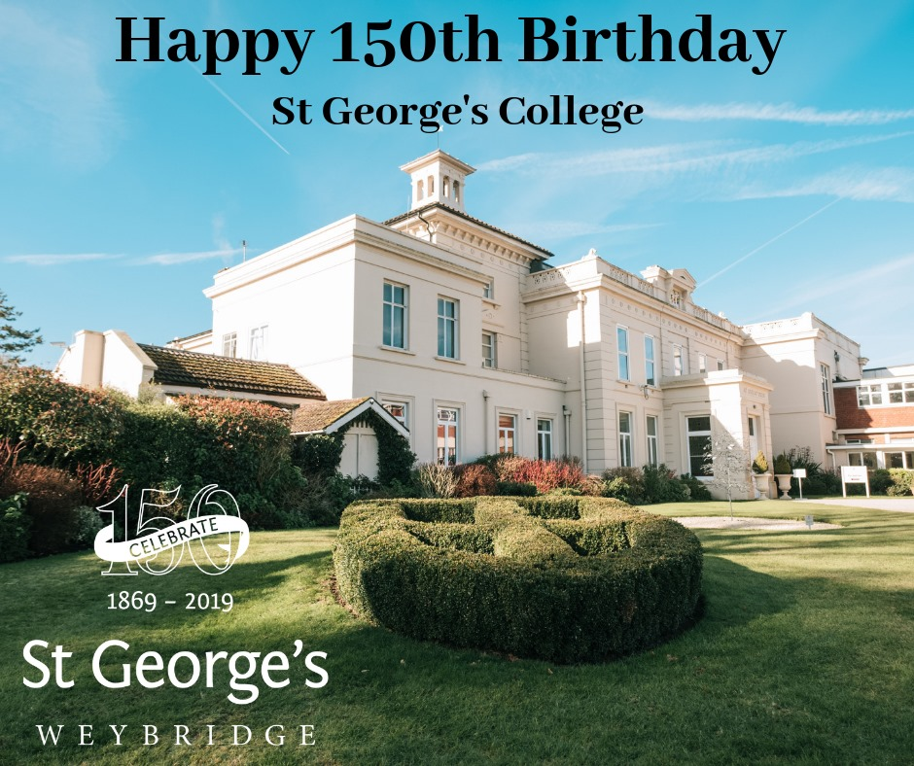
World Events Politics & Scandal Music Films & TV Fashion

Slide 3

UK and World Events

Slide 4
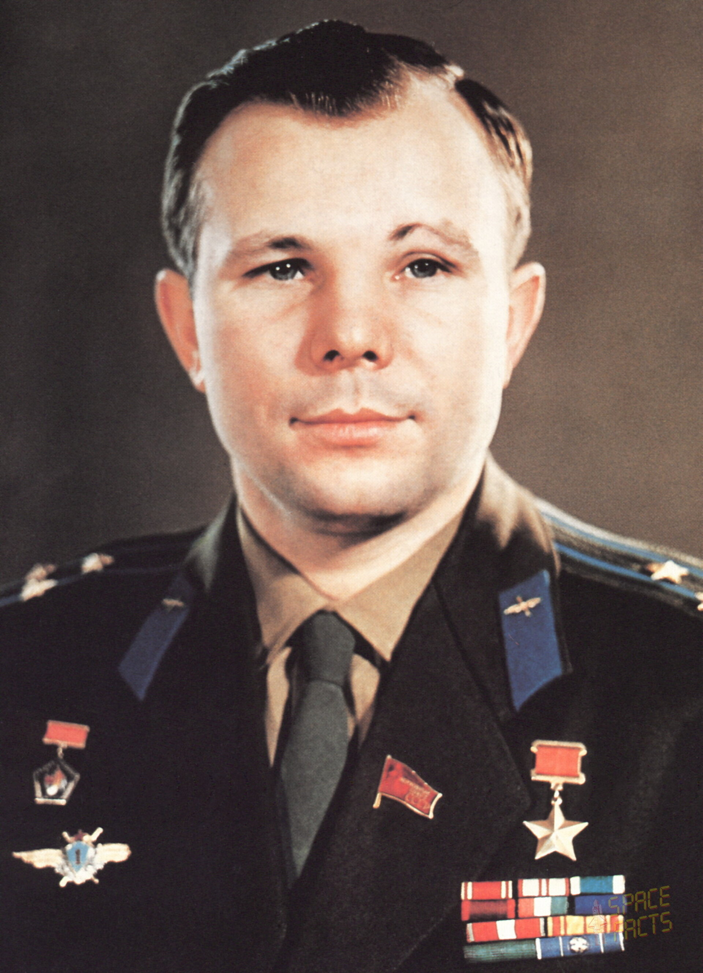
The First Man in Space Who? When?

Slide 5
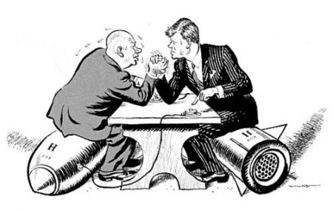
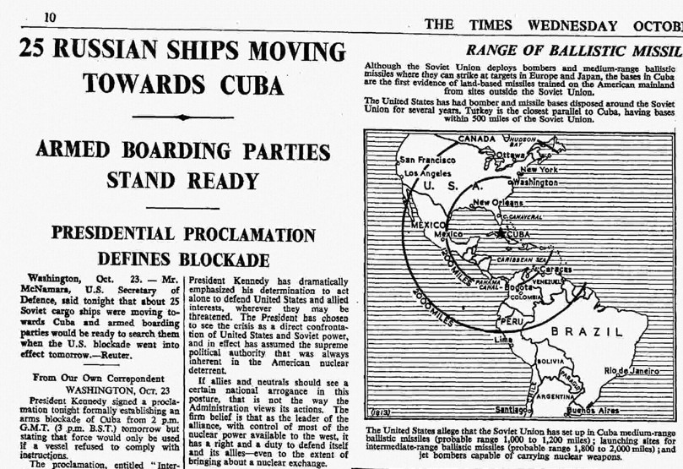
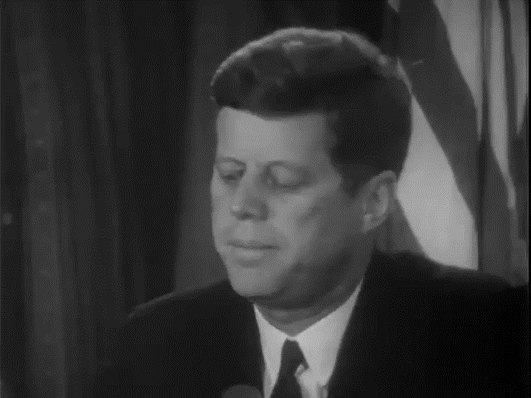
The Cuban Missile Crisis When?

Slide 6
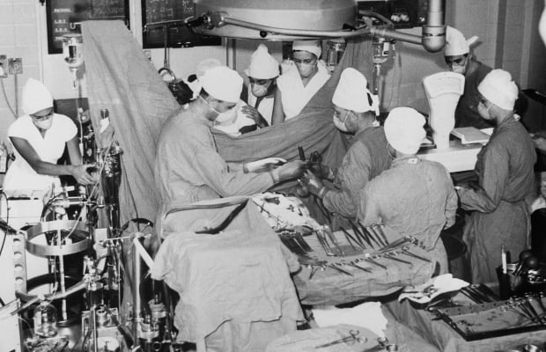
World’s First Heart Transplant Surgeon? Where? When?

Slide 7
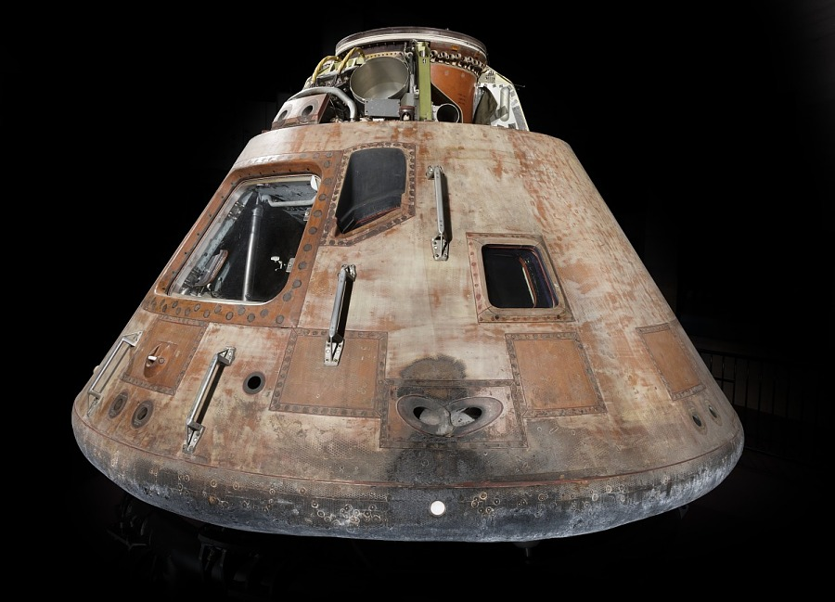
Apollo 11 Moon Landing Who remained in the command module? What was it called?

Slide 8
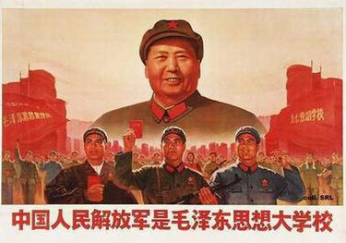
Cultural Revolution Started when?

Slide 9
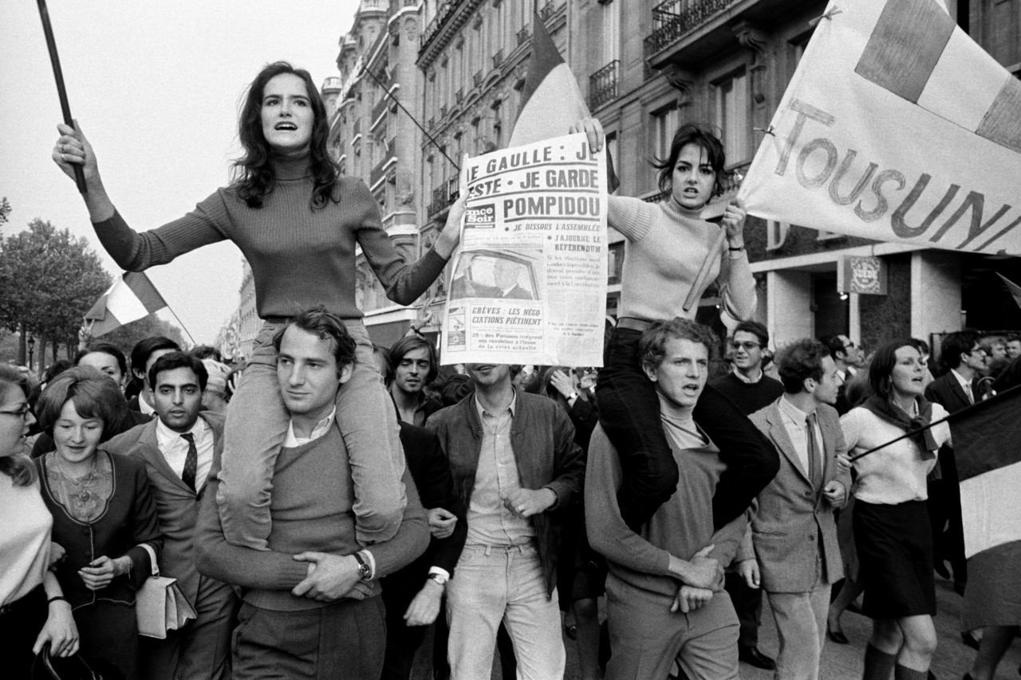
‘Les Evenements’ Started when (month and year)?

Slide 10
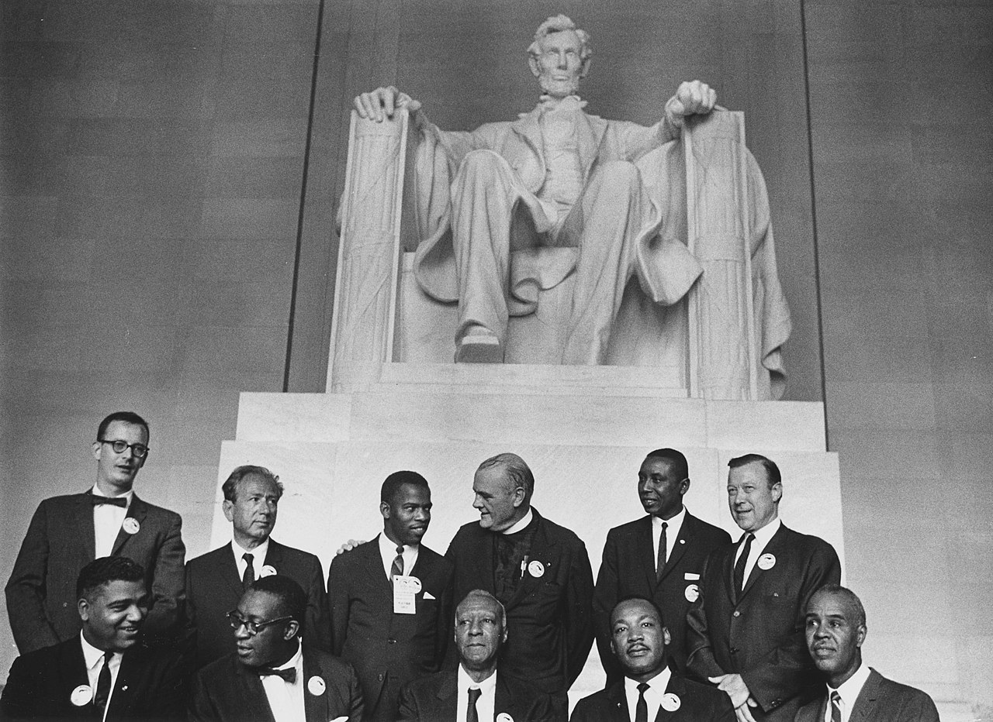
Civil Rights Movement March on Washington When?

Slide 11
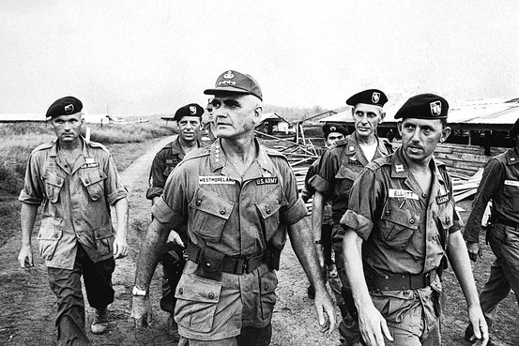
Vietnam Four Star US General 1964-1968 Who?

Slide 12
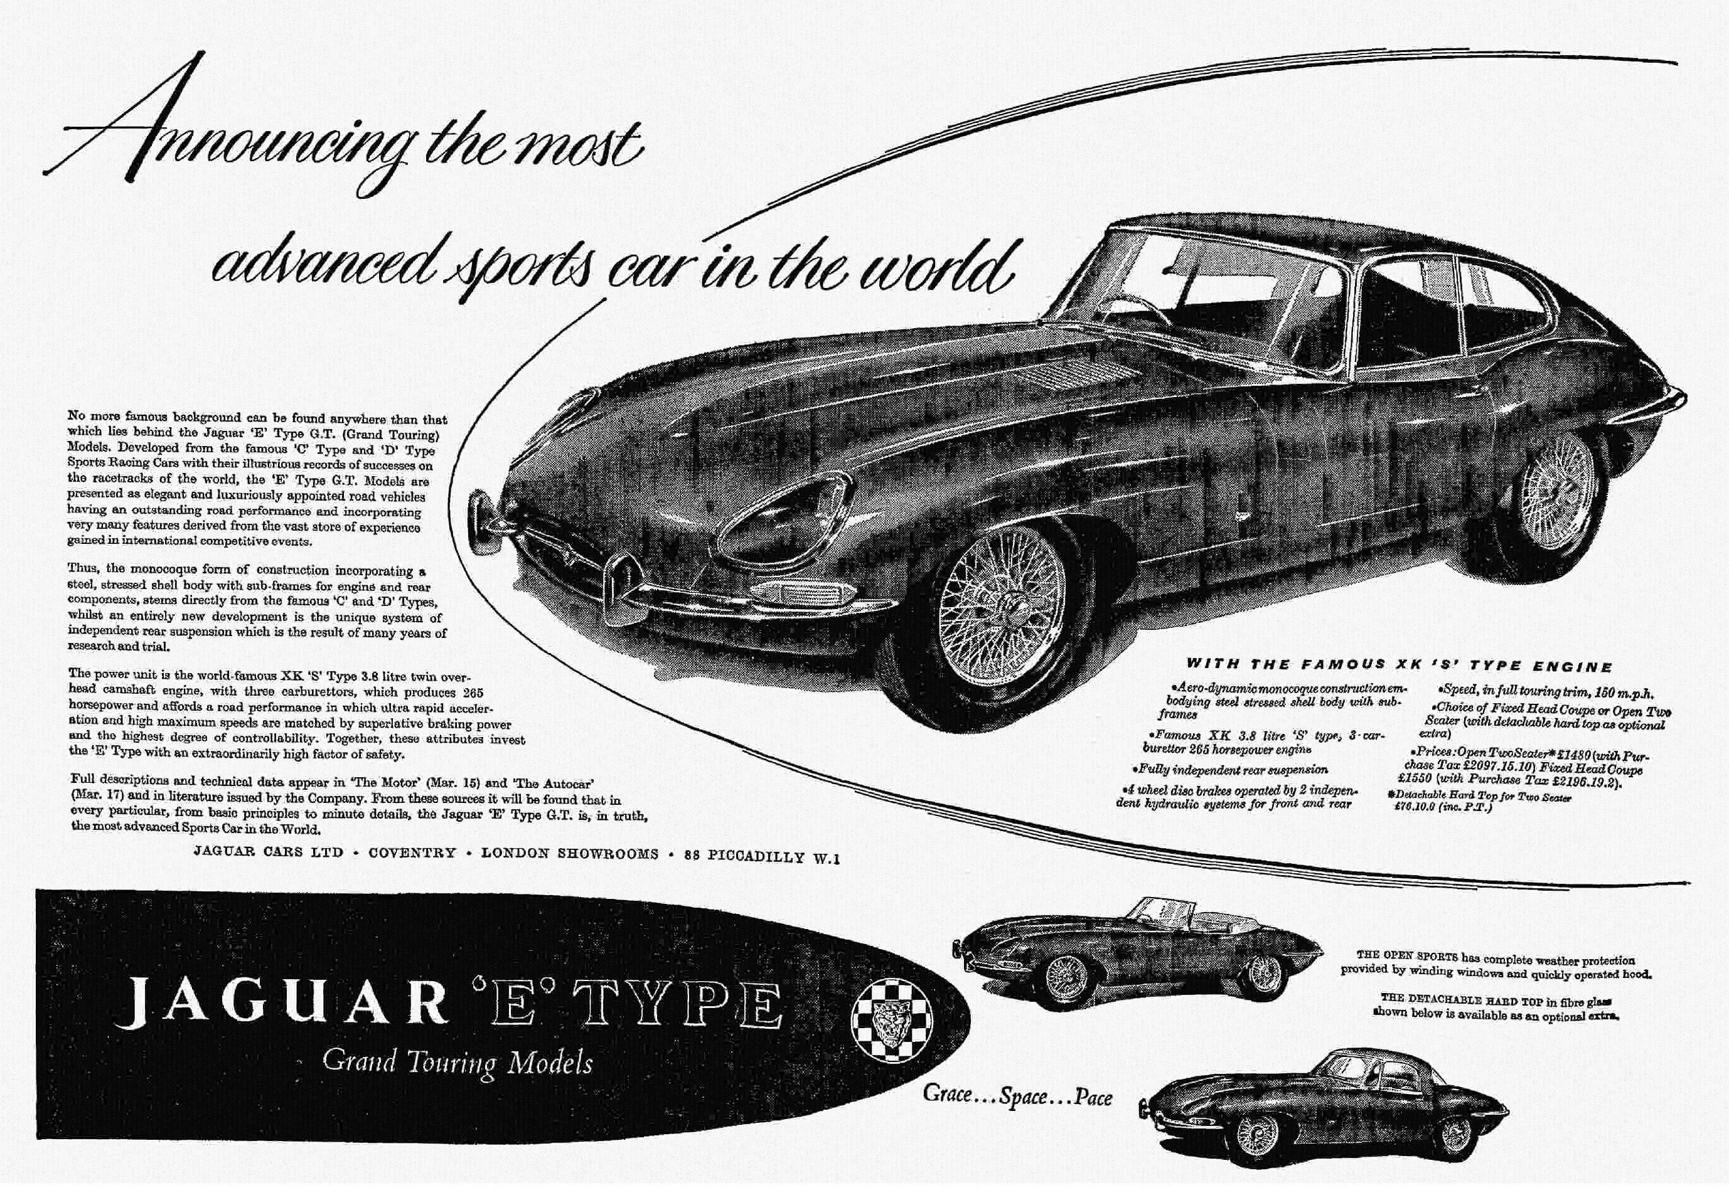
Launched When?

Slide 13
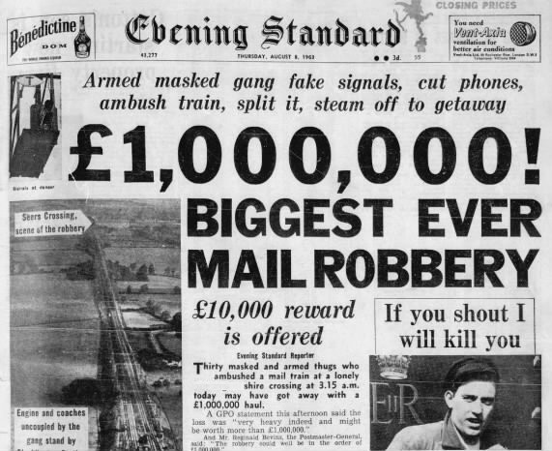
Great Train Robbery When? County?

Slide 14
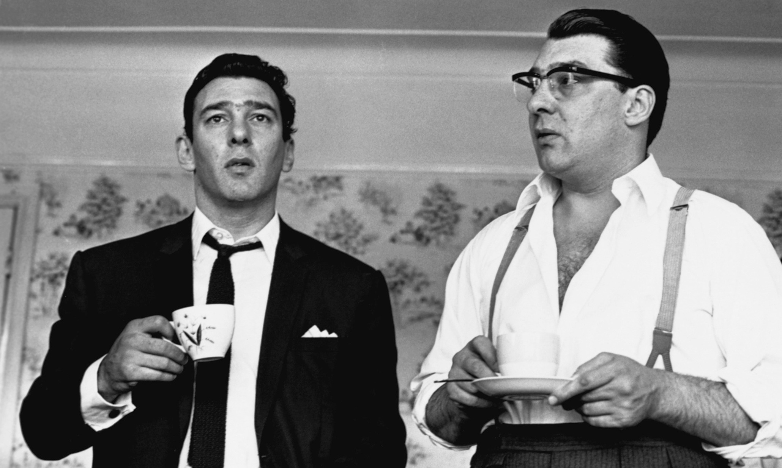
The Kray Twins Trial When?

Slide 15
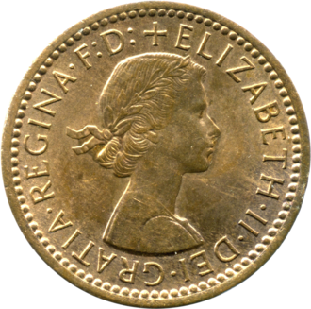
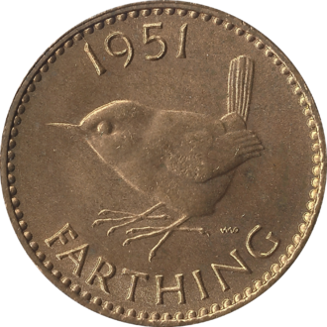
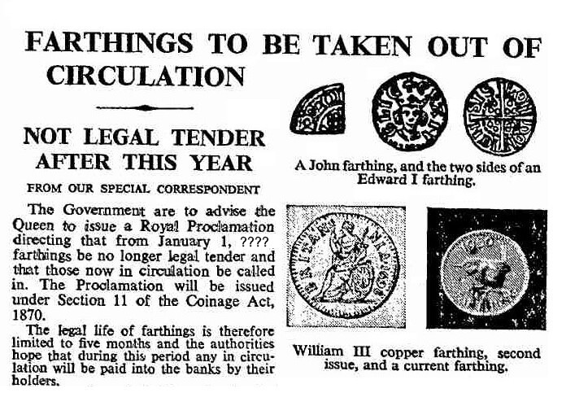
The end of which year?

Slide 16
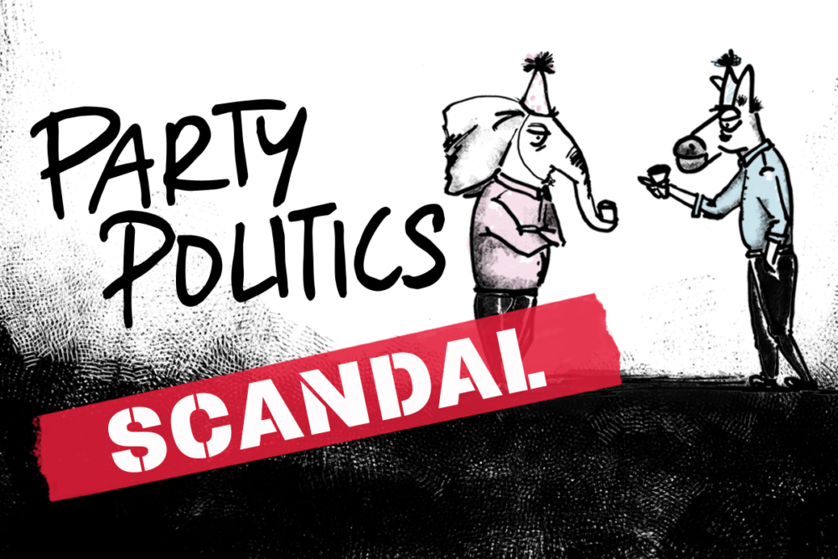

Slide 17
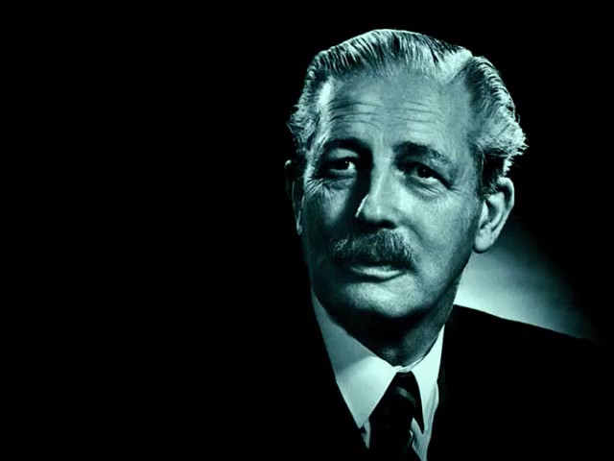
Wind of Change Speech Where (city)? When?

Slide 18
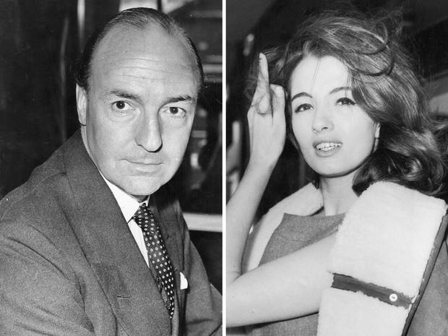
Profumo Affair Country House? Osteopath? 1989 film title?

Slide 19
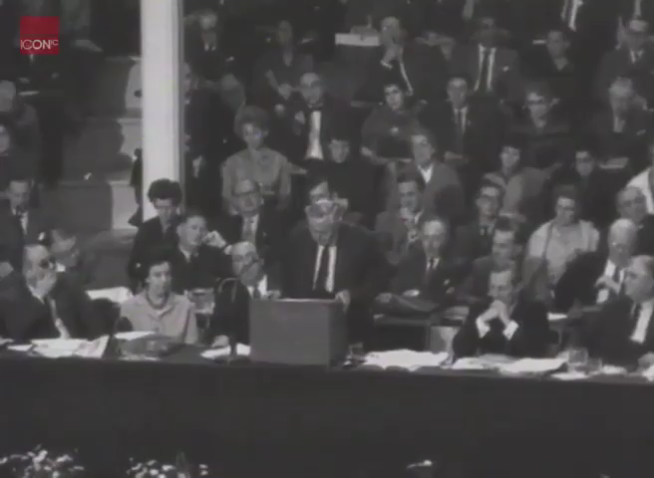
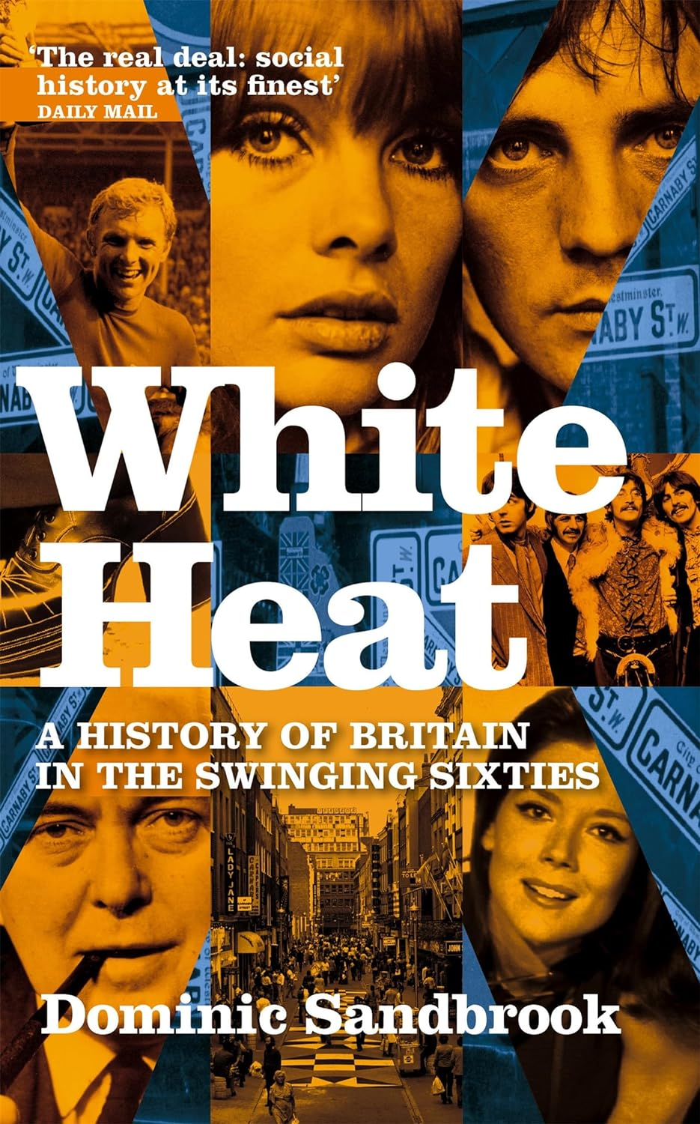
Harold Wilson White Heat Speech Event? Where? When?

Slide 20
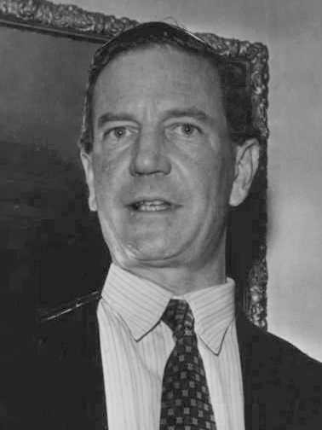
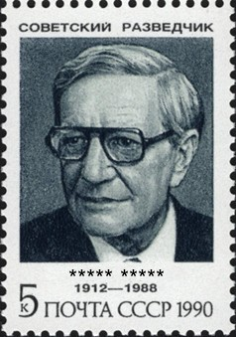
Who? ‘Outed’ when? Cambridge College?

Slide 21
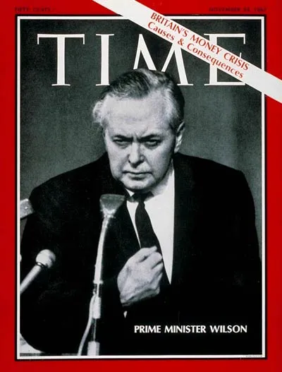
Sterling Devaluation When? Chancellor? New Rate?

Slide 22
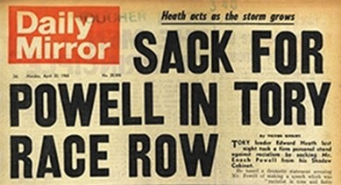
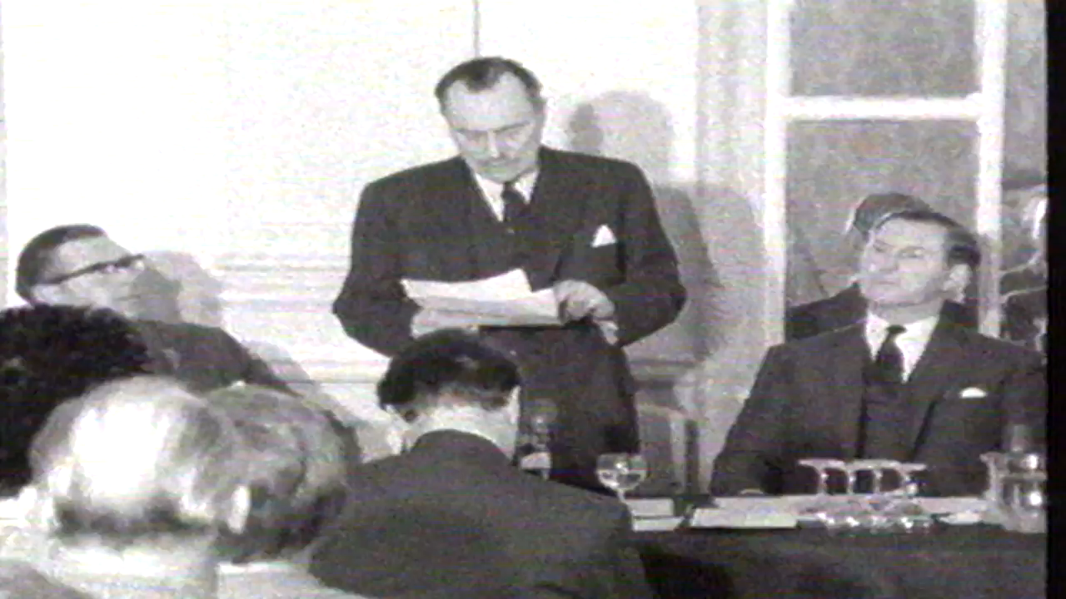
Enoch Powell Rivers of Blood Speech Where? When? Who did he quote?

Slide 23

Theatrical Censorship started when (century)? Abolished When?

Slide 24
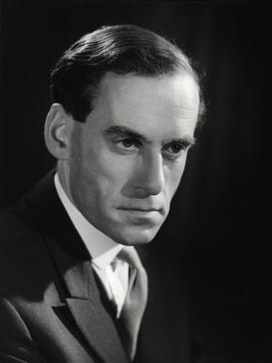
Liberal Party Leader From When? Succeeded Who?

Slide 25
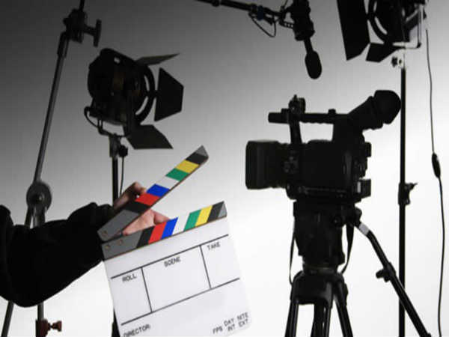
Film and TV

Slide 26
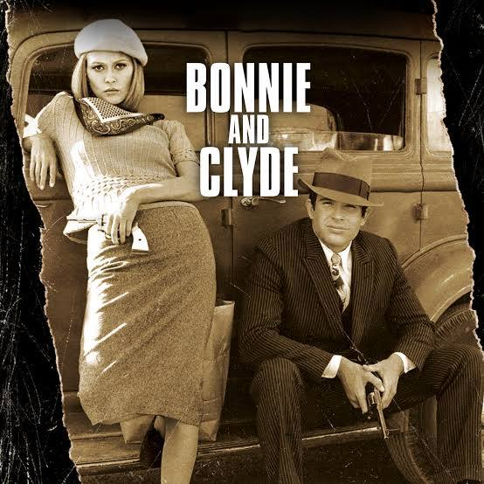
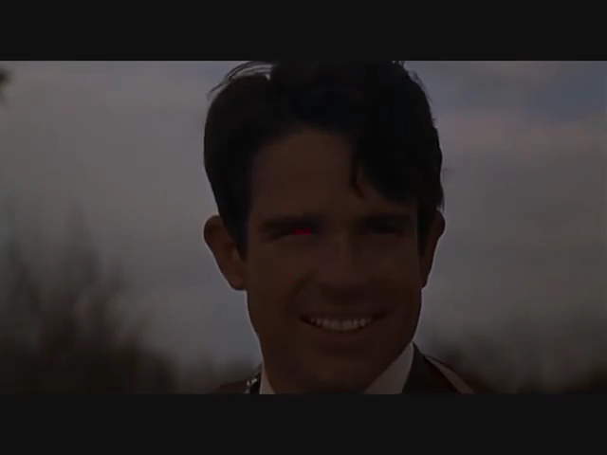
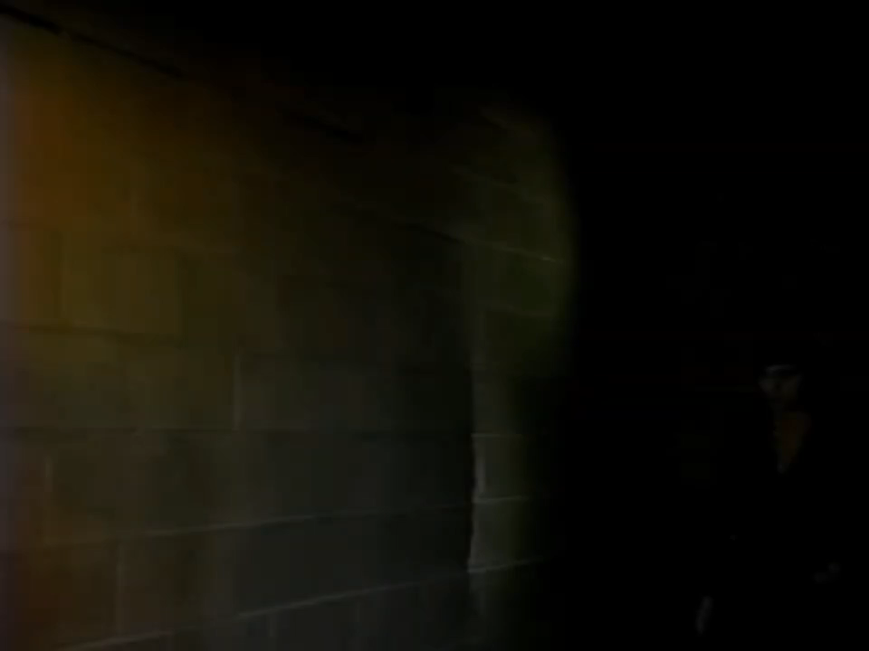
Theme Music? Ballad Singer?

Slide 27

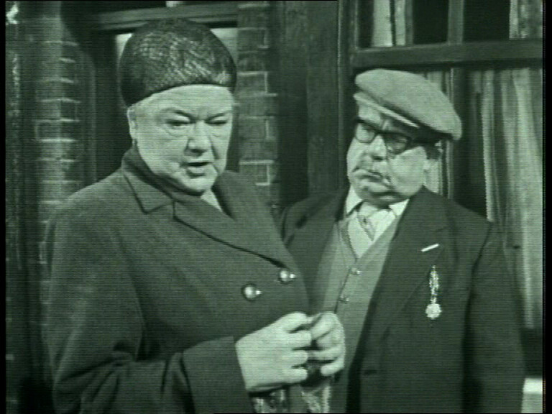
Started When? Character Names?

Slide 28
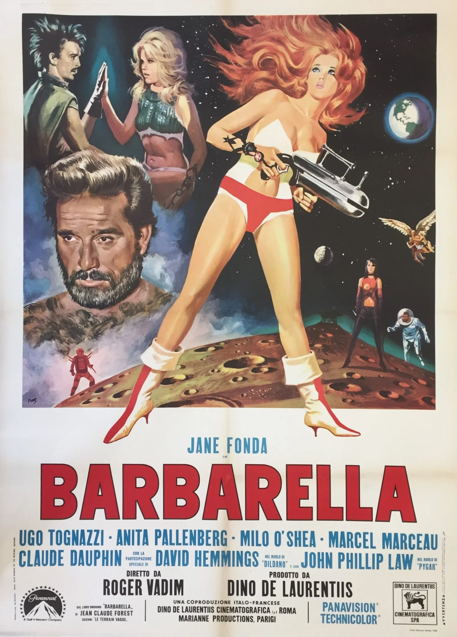
Which British band was named after a character in the film?

Slide 29
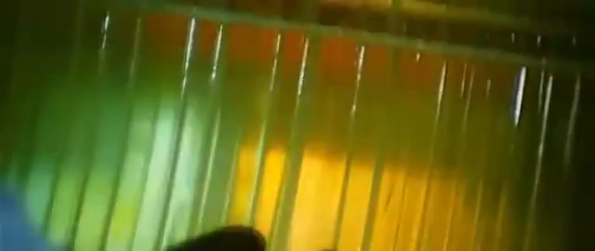
What was this machine called?

Slide 30
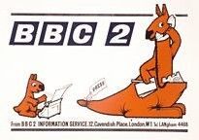
Started When? Mascot Names?

Slide 31
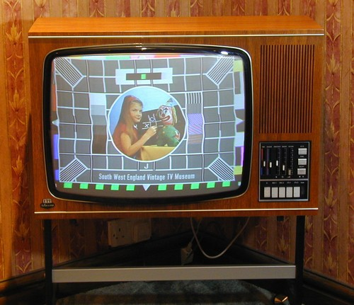
Colour Television Started when?

Slide 32
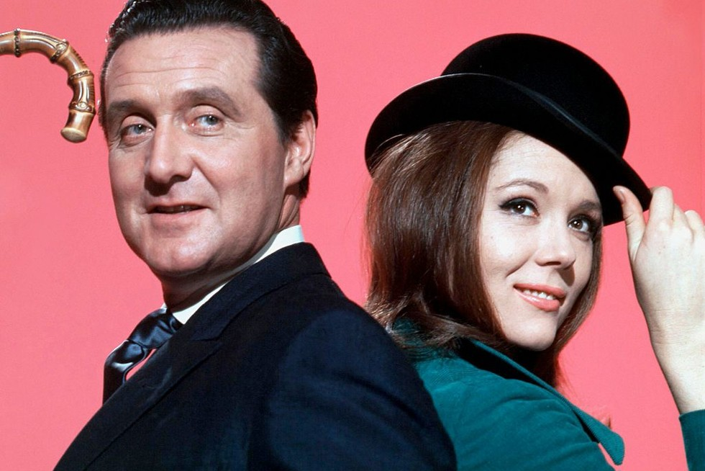
Diana Rigg’s Predecessor? Successor? (real names)

Slide 33
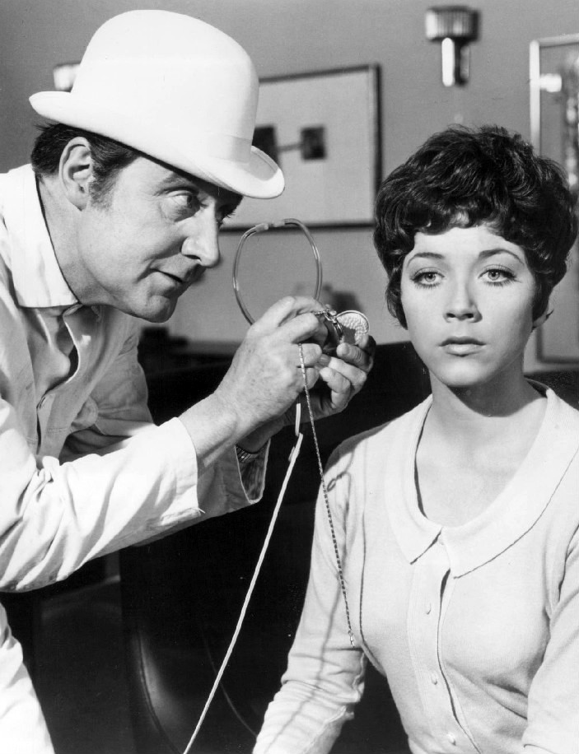
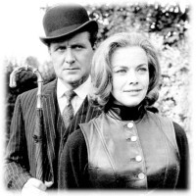

Slide 34
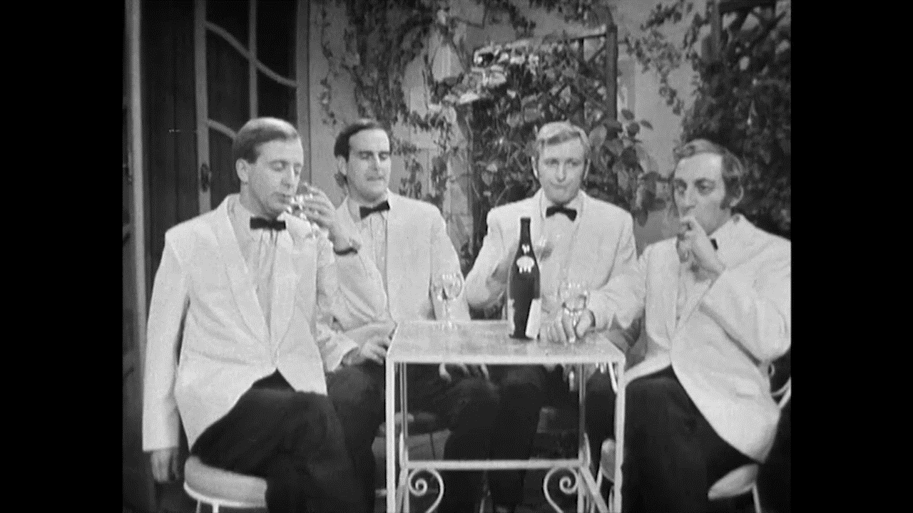
Four Yorkshiremen Sketch Comedy Series? When?

Slide 35
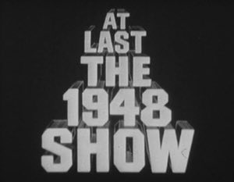
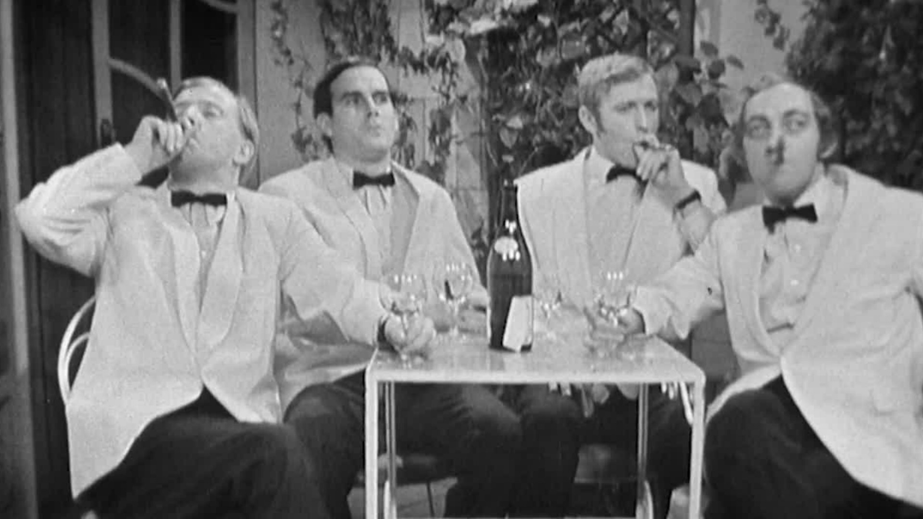

Slide 36
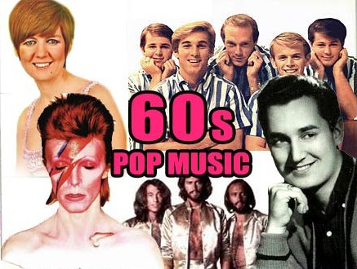

Slide 37
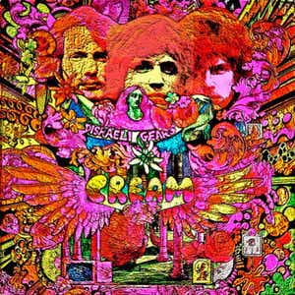
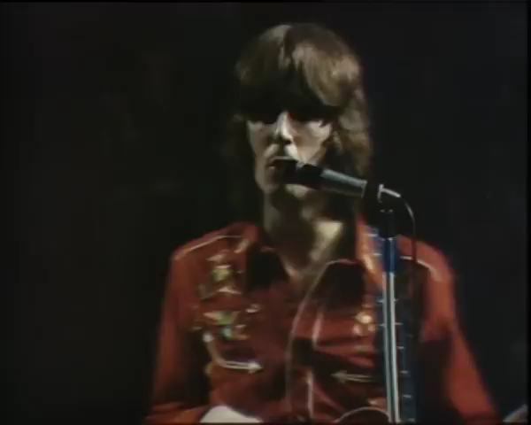
Farewell Concert Where? When?

Slide 38
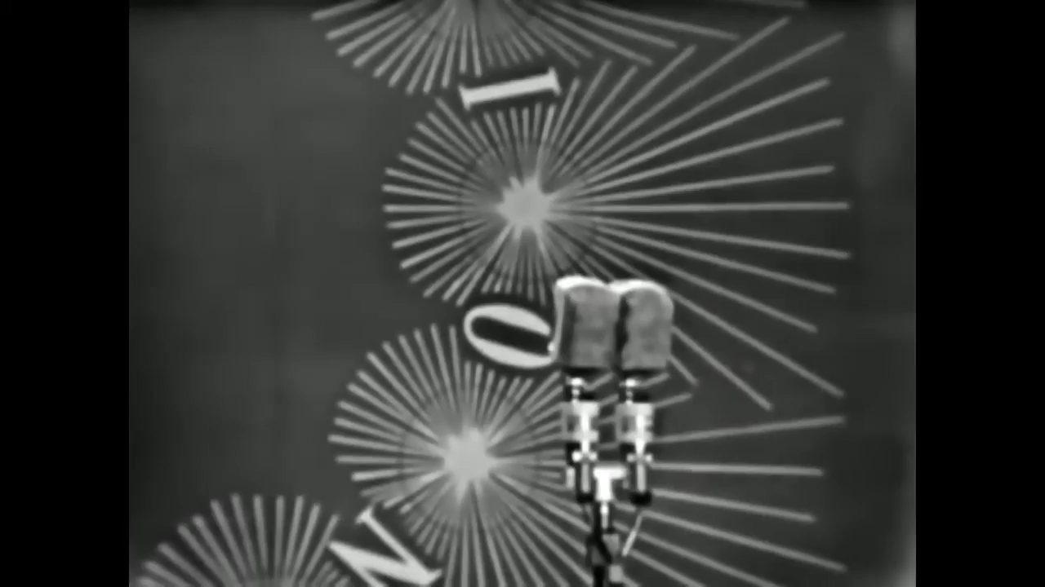
Eurovision Song Contest Winner When? Singer? Composer?

Slide 39
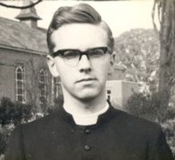
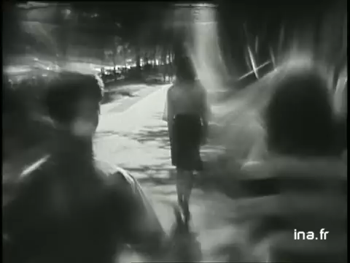
Who? Married to?

Slide 40
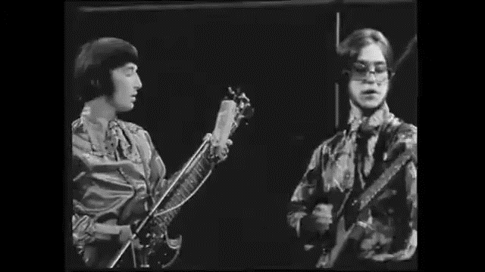
Who were Terry? Julie?

Slide 41

Who split his trousers? When?

Slide 42

Fashion

Slide 43

Who? Founded his fashion label in which year?

Slide 44

Real name? 1960s boyfriend and manager?

Slide 45

What style? Why so called?

Slide 46

Shoes called what? Popular with whom?

Slide 47

Designer? Dress of the Year when?

Slide 48

Who? Fashion Style?

Slide 49

Pattie Boyd Dolly Girl

Slide 50

Boots called? Singer? Song?

Slide 51


Slide 52


